Slide 1

History and Overview of the Chemistry Law

Slide 2
1. History
RA 754 was promulgated on June 18, 1952
Discussions on revision started in 1998.
Bills filed in Lower House
  Nereus Acosta, Angelo Palmones, Florencio (Bem) Noel, Sonny Angara, Victoria Noel
Bills filed in Senate
    Richard Gordon, Edgardo Angara, Antonio Trillanes
Approved Senate and House bills: SB 914 (Trillanes) and HB 5016 (Noel)
Notes:
2

Slide 3
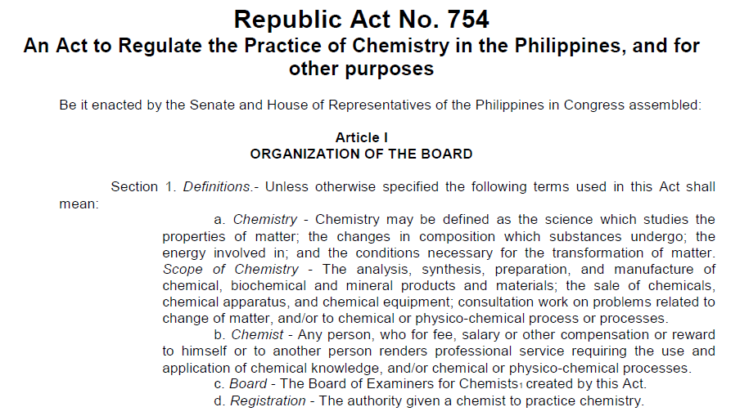
2. Overview
Notes:
3

Slide 4
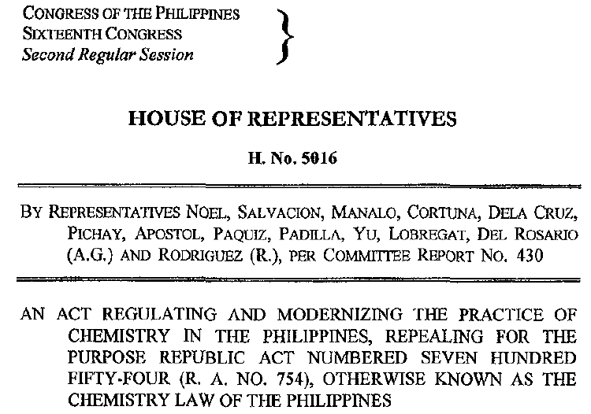
2. Overview
Notes:
4

Slide 5
2. Overview
Need to differentiate Chemistry as a Science and as a Profession:
  As a Science: to promote research and discovery, interdisciplinary and international collaboration
  As a Profession: to protect the public welfare and safety, local and international accreditation, local and international commerce
Update the Definition and Scope of Chemistry (Sec. 3)
Notes:
5

Slide 6
2. Overview
Update the Definition of the Professional Practice of the Profession (Sec. 4) and relationship with Allied Professions (Sec. 41)
Define the Practice of the Chemical Technician (Sec. 5)
Qualifications of Applicant for Chemistry Examination (Sec. 16)
Scope of Examination for Chemists (Sec. 17)
Qualifications of Applicant for Chemical Technician (Sec. 18)
Scope of Examination for Chemical Technician (Sec. 19)
Notes:
6

Slide 7
2. Overview
Exemption from Examination for Chemists (Sec. 23)
Continuing Professional Development (Sec. 31)
Strengthening of Laboratory Registration and Inspection (Secs. 35, 36, 39)
Coverage of Professional Practice (Sec. 41)
Hazard Pay, Health and Accident Insurance, Legal Assistance (Sec. 42)
Grace Period (transitory provisions) (Sec. 46)
Notes:
7

Slide 8

Discussion on the
CHEMISTRY LAW
This is a summary of the main points made in the Presentations and Open Forum held at the PNP Multipurpose Hall, Feb 17, 2015. These notes are for the purpose of discussion only.

Slide 9
General
The Chemistry Law regulates Chemistry as a profession but not as a science (e.g., research).
There are updates the definition of chemistry, the scope of the professional practice of Chemistry, and its relationship with allied professions.
  Focus on the protection of public welfare, the protection of the environment, and the professional practice of Chemistry.
  More attention on the laboratory accreditation
Courses covered by the Chemistry licensure exam – Organic, Physical, Inorganic, Analytical, and Biochem – should be taught by registered chemists; advanced courses, e.g. Advanced Inorganic Chemistry, can be taught by anyone deemed qualified by the school.

Slide 10
Chemical Technician
RA 754: Minimum requirement is 5 years experience in laboratory work
New law: The description of the Chemical Technician was updated.
There are two ways by which an individual can become a Chemical Technician:
  Applicants who pass any two subjects in the Chemistry licensure examination automatically qualify to become a Chemical Technician.
  Completion of a TESDA-approved course for Chemical Technician will qualify the individual to take a licensure examination for Chemical Technician to be administered by the Board of Chemistry.
  There is no limit to the number of times an applicant can take the Chemical Technician exam.

Slide 11
Chemical Technician
TESDA will work with CHED and PRC for the development of its certification requirement for Chem Tech.
TESDA, SPIK, and ICP are currently working on the formation of guidelines in the training of the QA technicians (NOT Chemical technicians)
  May include the qualification of the chemical technician
  Even with TESDA certificate you still need to take the licensure exam to get a PRC license.

Slide 12
Chemical Technician
All Chem Techs can do analysis but must work under a Registered Chemist even those working in shifts and in sister companies. This will need further evaluation during the drafting of the IRR.

Slide 13
Certificate of Analysis
  Signatories in Certificate of Analysis:
    “Analyzed by”: can be signed by Chem Tech
    “Certified by”: can only be signed by a Reg Chemist
    “Approved by”: signatory appointed by institution / company
    PRC licenses should be valid when signing COA and reports.

Slide 14
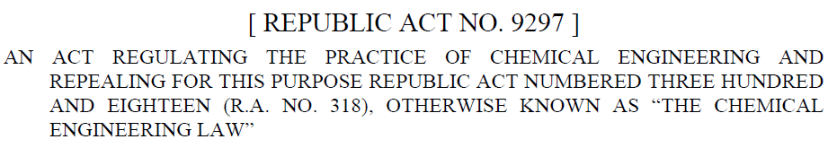
On Chemical Engineers
The Chemical Engineering Law (RA 9297) specifically excludes chemical analysis and the operation of a chemical laboratory from the Scope of Practice of a Chemical Engineer.

Slide 15
Research
Research can be done to improve analytical methods. This can be done by an expert who is not necessarily a registered chemist.
However, if the analysis is to be done to certify the properties of a sample, this should be performed by a registered chemist or chemical technician.
If the output is the publication of a method of analysis, this is classified as research and is not a restricted activity. But if the work is for an analytical report, then the certification should be done by a registered chemist.

Slide 16
Biochemistry & other allied courses
There is no board exam specific for BS Biochemistry and BS Agricultural Chemistry programs.
For an allied program to qualify for the Chemistry licensure exam, the program should be placed under the supervision of Board of Chemistry and the CHED technical panel for Chemistry.
  Hence, they must have the 5 subjects to cover 60 units of chemistry and the curriculum should have passed the evaluation of CHED technical panel of Chemistry.
Details will be further specified in the IRR.
The laws of allied professions may need to be reviewed prior to drafting the IRR.

Slide 17
Employment
The signatory should be a full time registered chemist employee of the company.
  You cannot practice as a chemist or chemical technician without an updated PRC license.
The law does not specify the salary rate of chemist.
Can the Board look into the “grandfather law” in the light of the new chemistry law?
  This will be looked into during the drafting of the IRR.

Slide 18
Sale of chemicals
Sale of chemicals and chemical equipment must be done by a registered chemist or chem tech under the supervision of a registered chemist. Allied professions can perform sales as long as this activity is in their own law.
Suggestion that chemists not exposed to chemicals but on the road (e.g. Sales) can work it out with their employer for the hazard pay.

Slide 19
Hazard pay
Section 42 compels the employer to provide the chemists with hazard pay. This will need to be aligned with DOLE.
Example, DOST: All chemists is covered with 30% hazard pay based on basic, supervisors/managers with less exposure has 23% hazard pay.
Magna carta is for government. For private companies including for academe, this will be taken up during the drafting of the IRR.

Slide 20
Hazard pay
To whom is the hazard pay applicable? Is it only applicable to registered chemists and chemical technicians?
How can we ensure that employers implement the hazard pay and not have them state that the hazard pay is already included in the basic pay?

Slide 21
Validity and seal
When signing a report, shouldn’t the validity date of the Chemist’s professional ID be included?
  This will be considered during the drafting of the IRR.

Slide 22
Accreditation of chemical laboratory
All chemical labs even under a manufacturing setup should have a certificate of authority to operate from the PRC Board of Chemistry.
PAB currently ensures that the approved signatory is competent. PAB will work together with PRC to ensure compliance with new chemistry law.

Slide 23
Accreditation of chemical laboratory
ISO 17025 is a voluntary accreditation and does not replace the accreditation by PRC Board of Chemistry.
For labs with doing multiple testing/functions, the certification of chemical test results must be done by registered chemist.
Even if you have an FDA permit to operate license you still need to apply for certificate of authority to operate
  It can be considered during the drafting of the IRR to have the regulatory agencies work together with the PRC Board of Chemistry to ensure that compliance to Chem law is upheld.

Slide 24
K-12 Program
The new DepEd curriculum does not provide enough depth to encourage the interests of students to take up chemistry.
  It is recommended that we take this up with DepEd and PACT.

Slide 25
Continuing Professional Development
Continuing Professional Development (CPD) is a requirement. For the IRR, it should be specified that a chemist should have 60 units in 3 years to be able to renew the PRC ID.
The classification of CPD units (credits to be given) is already included in the PRC guidelines. PRC already has its own guidelines- a table for equivalent units to earn CPD.

Slide 26
Information dissemination
How can we increase awareness of the new law to ensure compliance?
We should consider all means possible to disseminate the information including possibly provide same symposium to different sectors.
Important role of ICP chapters, all ICP members, Chemistry departments.

